Slide 1
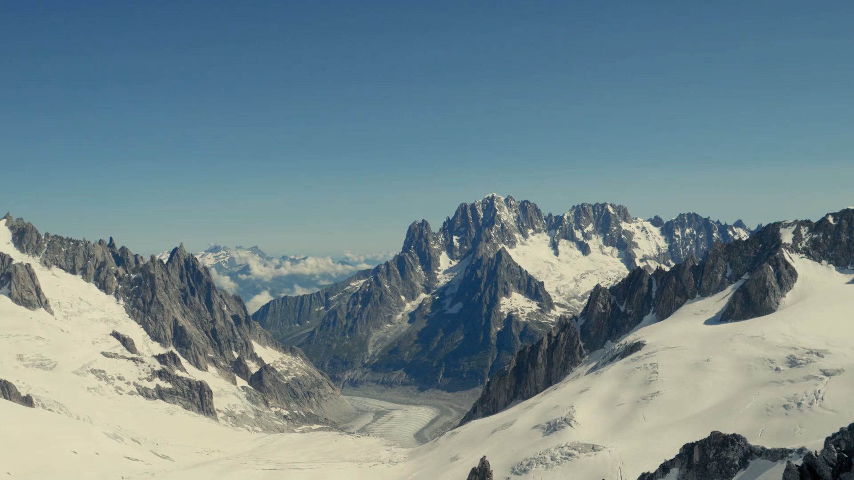
How to Increase the Revenue for the Big Mountain Ski Resort
Notes:
Hypothesis: Create a Hypothesis with an emphasis on SMART principles. (S – Specific, M – Measurable, A – Achievable, R – Realistic, T – Timebound). If you cannot do this, you do not have a good grasp on the business problem.
Context: With context, we have clearly identified the problem at hand and have elucidated on how our initiative may solve this problem, alongside the commercial implications this will have on the business.
Criteria for Success: Clearly defining the criteria for success ensures that the scope of your work is clearly defined and understood. Otherwise, if this isn’t defined – your work will never end which will result in mismatched expectations.
Scope of Solution Space: Scoping out the solution space ensures that the business initiative is SPECIFIC for a certain segment or area. This prevents solutions that have been developed being scaled and applied for all other business units that the solution may not be responsible or scalable for.
Constraints within Solution Space: Looking forward, what are the foreseeable problems we are likely to encounter? Could this be stakeholder resistance? Could this be we don’t have access to the right data?
Stakeholders to provide key insight: Who are the people I need to speak to, to get the answers I need for my data analysis?
What key data sources are required?
Based off my discussions with the key stakeholders – can we clearly list out all the data sources we need so we can make a highly targeted request as opposed to a scatter-gun approach where we ask for a bit of everything?

Slide 2

Problem Identification
Installed a new chair lift to help increase the distribution of visitors across the mountain
Increased $1,540,000 operating cost for the additional chair
Need to select a better value for ticket price to increase avenue

Slide 3
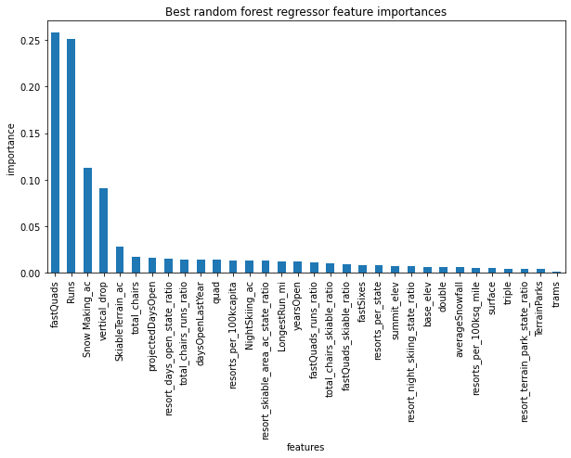
Exploratory Data Analysis
Top 6 important features for predicting ticket price
number of fast quads
number of runs
snow making area
vertical drops
skiable terrain area
total chairs

Slide 4
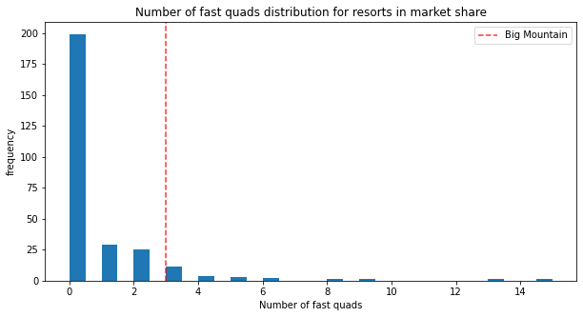
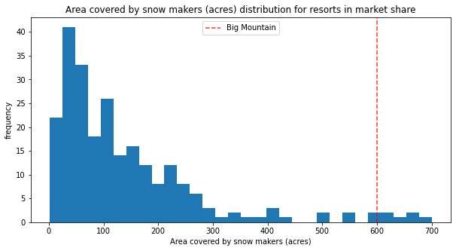
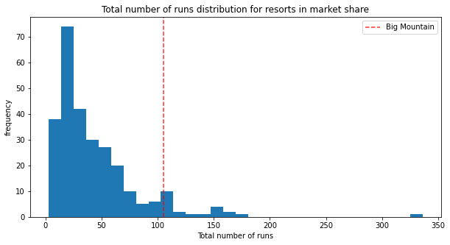
Key Findings of the Big Mountain Features

Slide 5
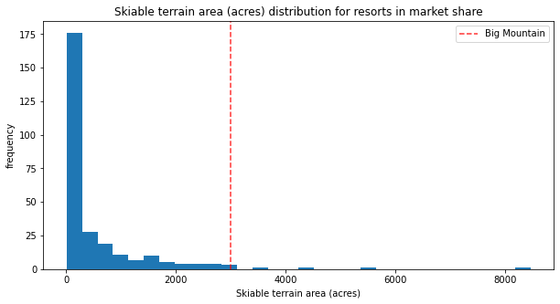
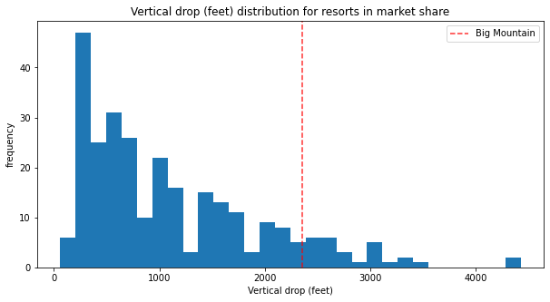
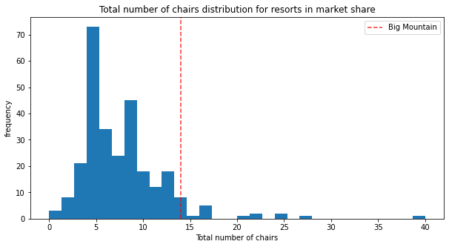
Key Findings of the Big Mountain Features

Slide 6
Modeling Assumptions
expected number of visitors over the season is 350,000 on average
visitors ski for 5 days on average
the provided data includes the new chair lift for the Big Mountain Resort

Slide 7
Modeling Result
The Model suggests $95.87 for weekend ticket price
with the expected mean absolute error $10.39

Slide 8
Recommendation for Future Improvement
Increase the vertical drop by adding a run to a point 150 feet lower down
install an additional chair lift to bring skiers back up

Slide 9
Conclusion
The Big Mountain Resort can increase weekend ticket price to $85.48
The expected revenue increase will be $7,840,000 by the end of this season.

